Slide 1

Predicting King County House Prices
the dataset is from kaggel

Slide 2
Introduction::
King county house prices dataset :This dataset includes the prices of homes in King County, Washington between May 2014 and May 2015. We will deal with 17 features of the homes. The Goal is to predict the house sales based on the features using Multiple Linear Regression (MLR).

Slide 3
grade - An index from 1 to 13, where 1-3 falls short of building construction and design, 7 has an average level of construction and design, and 11-13 have a high quality level of construction and design. | date - Date of the home sale
sqft_above - The square footage of the interior housing space that is above ground level | price - Price of each home sold
yr_built - The year the house was initially built | bedrooms - Number of bedrooms
sqft_basement - The square footage of the interior housing space that is below ground level | bathrooms - Number of bathrooms, where .5 accounts for a room with a toilet but no shower
yr_renovated - The year of the house’s last renovation | sqft_living - Square footage of the apartments interior living space
zipcode - What zipcode area the house is in | sqft_lot - Square footage of the land space
lat – Lattitude \ long - Longitude | floors - Number of floors
sqft_living15 - The square footage of interior housing living space for the nearest 15 neighbors | waterfront - A dummy variable for whether the apartment was overlooking the waterfront or not
sqft_lot15 - The square footage of the land lots of the nearest 15 neighbors | view - An index from 0 to 4 of how good the view of the property was
 | condition - An index from 1 to 5 on the condition of the apartment

Slide 4
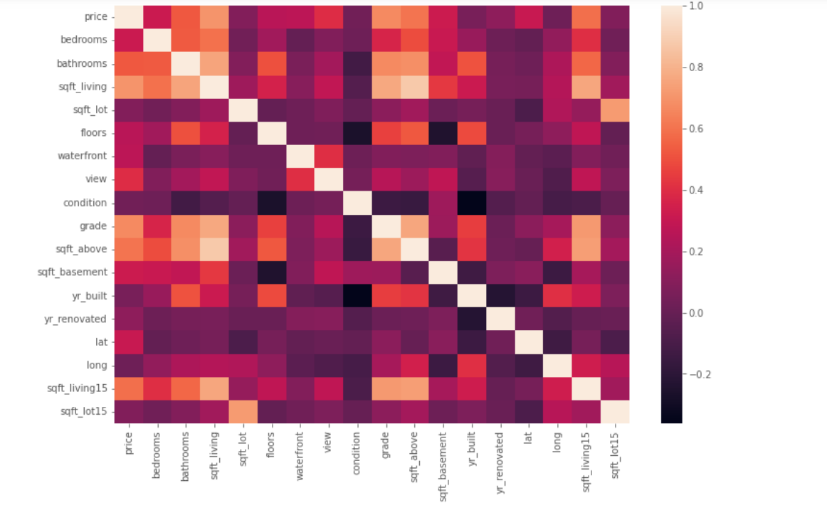
According to this chart(heatmap) , it show the correlation between variables.
And we see how are the features affect on price
The Goal is to predict the house sales based on the features using Multiple Linear Regression (MLR) by answering some questions :
1- Does the size of the house affect its sale price?
2- Dose the price of house differ according to specifications ?
3-Does the number of bedrooms affect the price of the house when it is on sale؟

Slide 5
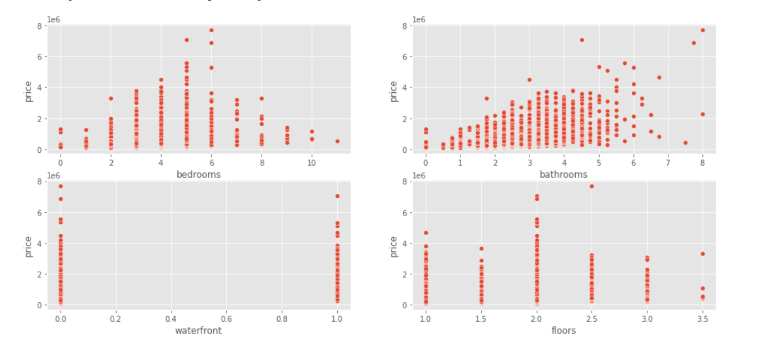
In this chart show how the price is affected in certain features . As we see price is very changeable with number of bedrooms and bathrooms and we can’t say the price is increase when the number of bedrooms is increase at all time ..

Slide 6
Mean
EDA and Model
Data cleaning and Data Visualization:
1- Check the null value and duplicated rows .
2-We find some of outliers values and solve it.
3- Let's drop unnecessary features
4- Change the Pandas datetime format

Slide 7
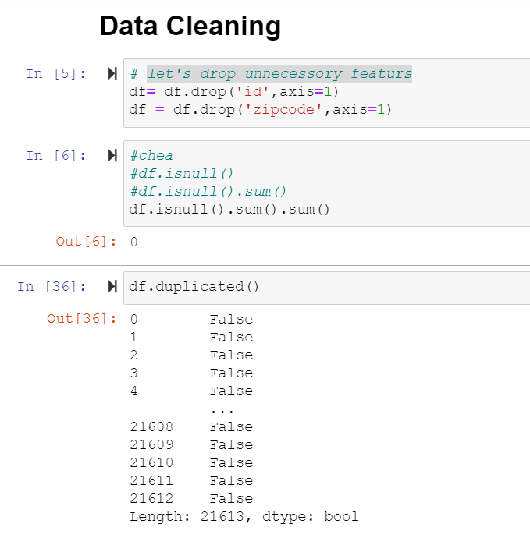
In data cleaning we check the null value and duplicated value .
Also we drop unnecessary features
There is no null value in this dataset
Also there is no depilated rows

Slide 8
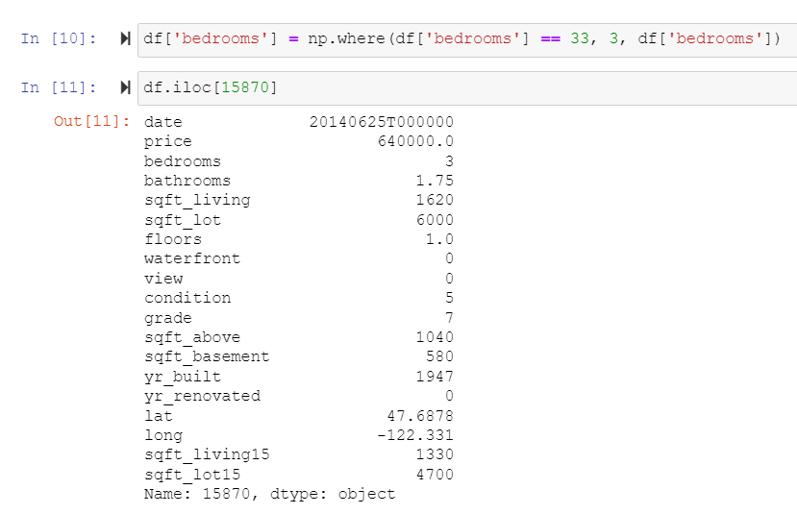
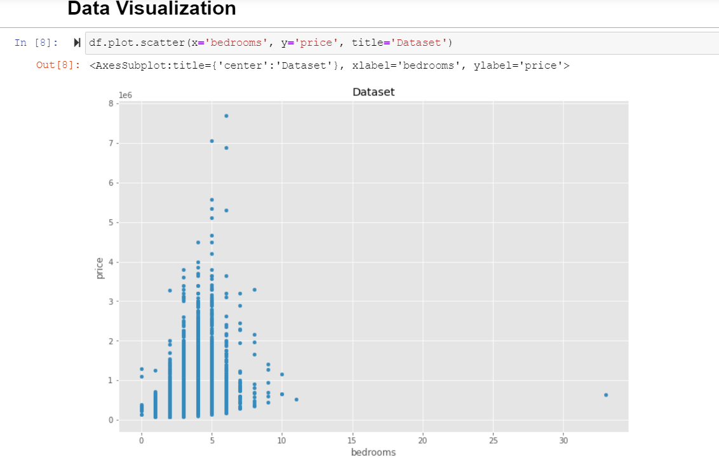
The outliers in the bedroom column are obvious so need to be handle. maximum value of bedroom is 33!
We can notice in the first row in the previous table that the value of 33 was assigned to the number of bedrooms by mistake, so that it is not reasonable that the number of bedrooms and the number of toilets is 1.75 in the same house.

Slide 9
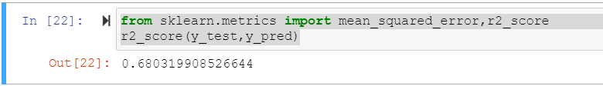
Creating Lineer Regrasion Model:
1- we define X and Y (X= df.drop(['price','date'],axis=1).values
y = df['price'].values ) .
2- Splitting the dataset into the Training set and Test set
from sklearn.model_selection import train_test_split
X_train, X_test, y_train, y_test = train_test_split(X, y, test_size=1/3, random_state=0)
3- Fitting Simple Linear Regression to the Training set
from sklearn.linear_model import LinearRegression
regressor = LinearRegression()
regressor.fit(X_train, y_train)
4- y_pred = regressor.predict(X_test)
5- find the R-Square from sklearn.metrics import mean_squared_error,r2_score
r2_score(y_test,y_pred)

Slide 10
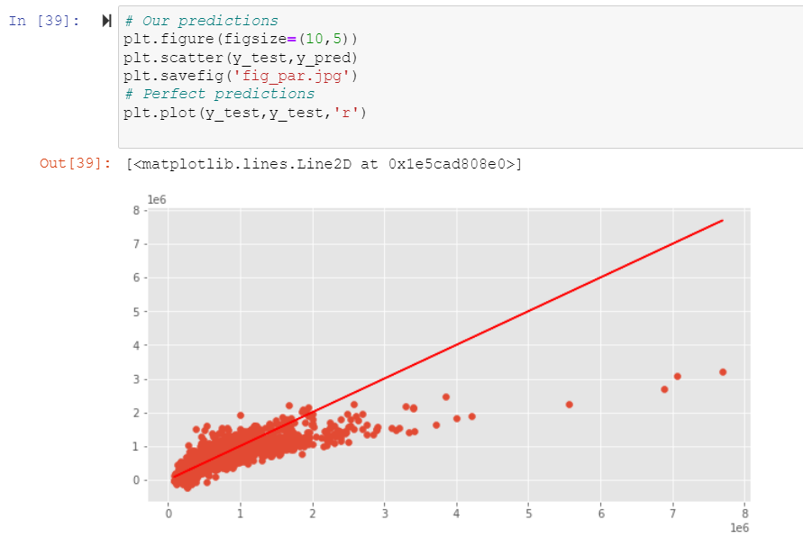
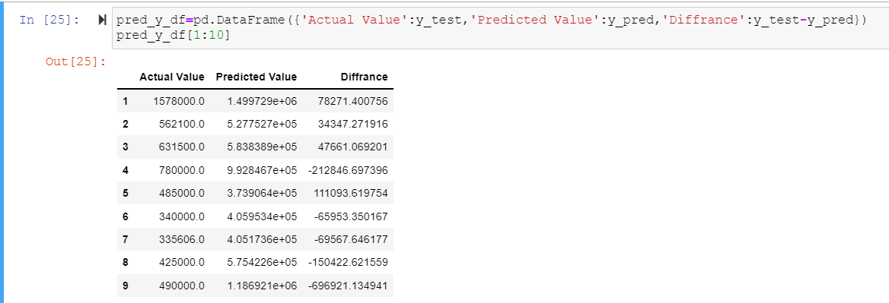
By visualizing the result we can see a normally distributed which is a proof of having a linear relationship , and the linear regression is positive according to the plot .
We created DataFrame show Y predect .
We do this step to measure how far our predictions are from the real house prices.

Slide 11
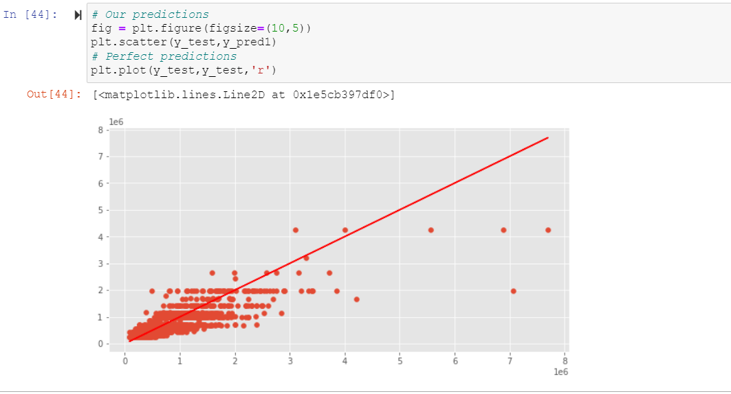
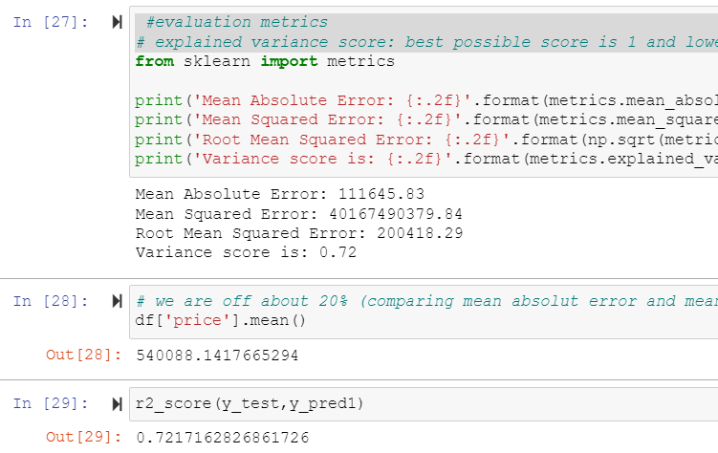
Evaluation on Test Data:
* We used decision tree model to evaluate the linear regression model .evaluation metrics
* Explained variance score: best possible score is 1 and lower values are worse

Slide 12

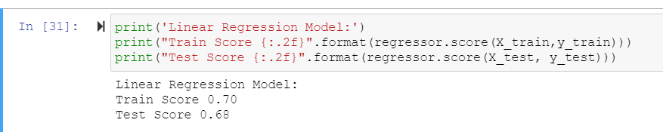
Final result :
This R-Square of Linear Regression model .
And this is R-square of evaluation .
The result is not a big difference
and the result is perfect .
By examining the data, we can determine that the price of a house is determined by various features, including the number of bedrooms (the most important one), the number of bathrooms, the square footage of the living area, the square footage of the lot, and the level of the floor. It is also affected by the location of the house where it is located. The other features, such as waterfront and view, are less dependent on the price.

Slide 13
Done by : Nada Saad Abdullah and Abrar abdulhadi mihdhar
First, we thank God for granting us to attend this course ,We express our gratitude to Dr. Rasha , for her support and encouragement ,We also would like to express our deepest appreciation to all the bootcamp participants

